Slide 1
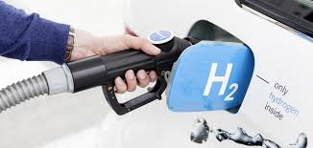
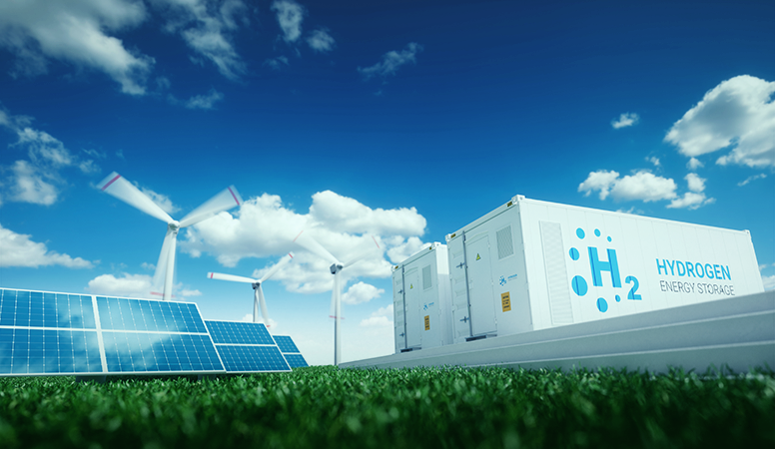
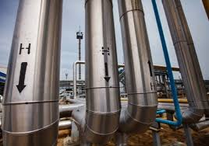



Hydrogen supply chain analysis using SERA
For Advisory Board call , 21st Oct 2021
Vishnu Vijayakumar
PhD candidate/NREL intern

Slide 2
Outline
Background
Modelling Approach- SERA optimization, interaction with other models and scenarios
Results
Conclusions and Future work
Research Questions

Slide 3






Background
roll out of infrastructure is an important piece to the hydrogen puzzle.
Cross sectoral applications for hydrogen require a multi sectoral analysis
Integrating hydrogen supply chain with the electricity and natural gas grids is critical during the energy transition.
We developed the STIEVE model to project hydrogen demand in California from on road transportation until 2050
Leveraged in-house electricity grid models to understand the impact of hydrogen integration on to the griD ( GOOD)
Now, we soft link these models with the hydrogen supply chain to understand How, when, and where will the capacity expansion of hydrogen production and delivery infrastructure happen in California, over a 2050-time frame

Slide 4
Modelling approach
Hydrogen supply chain analysis using Scenario Evaluation and Regionalization Analysis Model(SERA), developed by NREL.
SERA is a cost minimization model with spatial and temporal characterization.
Existing and new production technologies as well as various distribution technologies are competed economically to determine the lowest-cost supply chain.
SERA is soft linked to a suite of other models to obtain inputs .

Slide 5
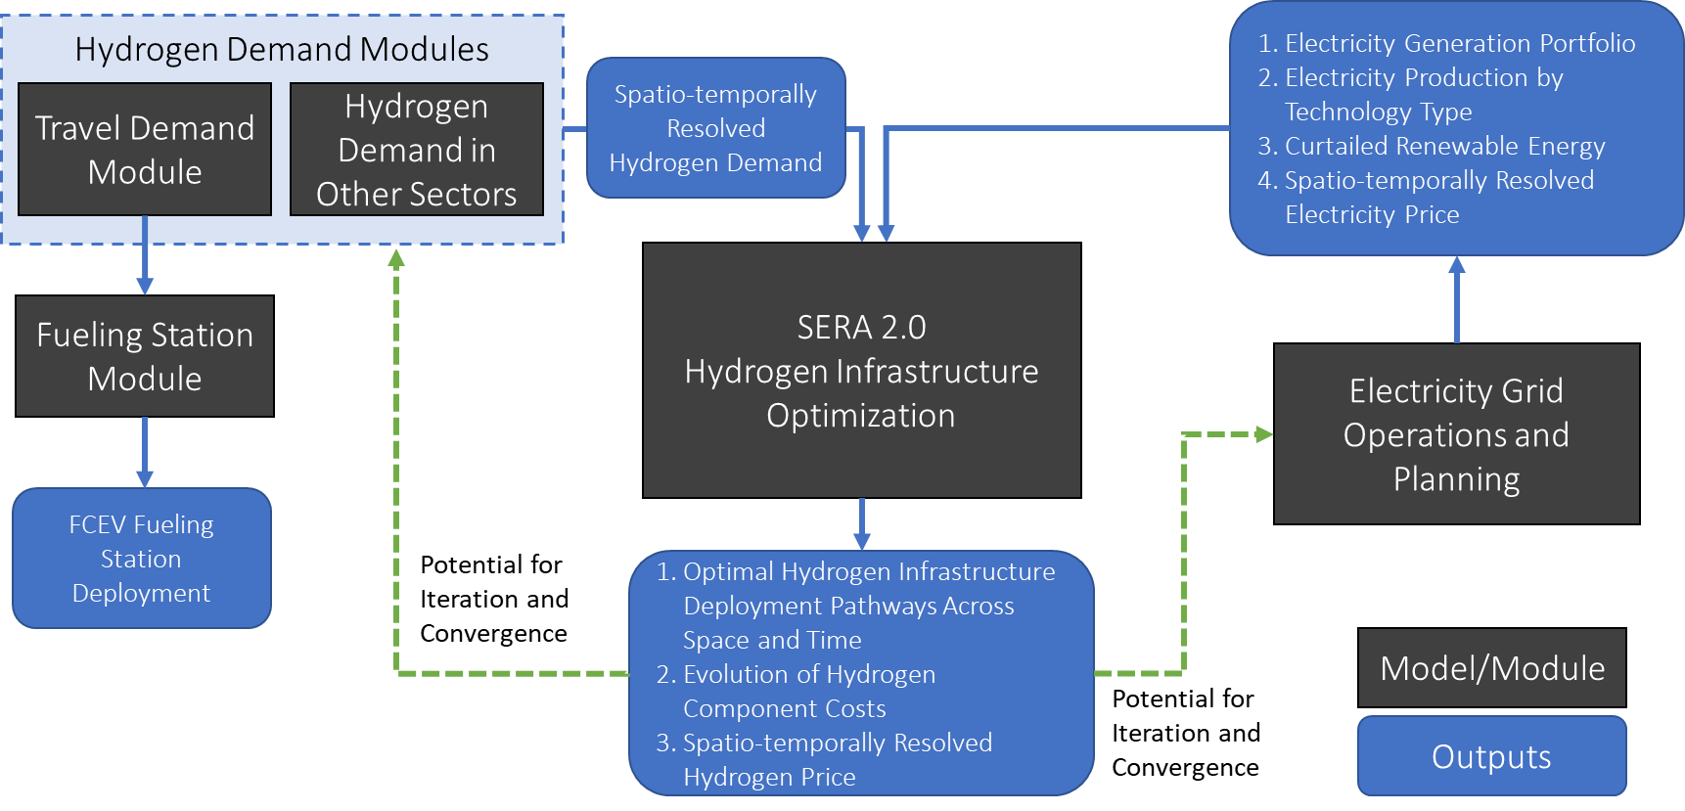
Model linkages
H2A,HDSAM HDRSAM
Capital, variable and fixed costs
Scaling and capacity factor
STIEVE
GOOD

Slide 6
Scenarios and Assumptions
What will the infrastructure build out look like in California
Low and high transportation demand
Perfect versus myopic foresight of demand
 | Scenario Description
Parameter of interest | Demand | Production | Distribution | Existing Supply | Planning Horizon
Evaluating the effect of varying hydrogen demand (Scenario – I) | Low | SMR with CCS and PEM | Pipelines, Gas tube trailer and Liquid tanker | SMRs (mostly refineries) -15% of nameplate capacity to meet transport demand Electrolyzers - expected to be online by 2022 | 5 years
 | High
 | High |  |  | Price: set at marginal cost of production
Impact of Optimization Time Horizon (Foresight) Scenario – II) | High |  |  |  | 12 years
 |  |  |  |  | 25 years

Slide 7
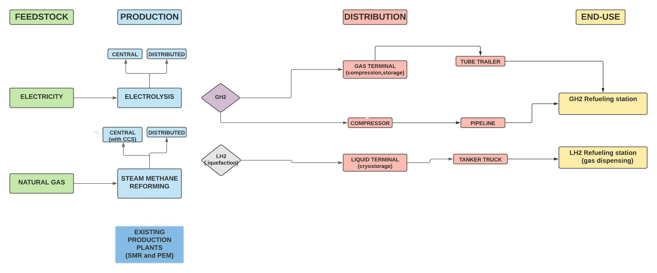
Hydrogen supply chain

Slide 8
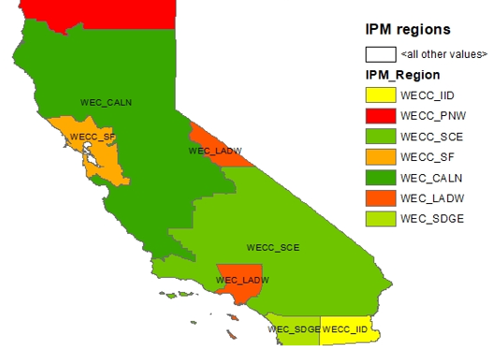
Some more background information
Feedstock prices
IPM region-based electricity costs(GOOD model) – 7 regions for California
Single region for diesel, NG, water prices(AEO 2021)
No price on carbon
No policy levers considered for hydrogen production, distribution or refueling
No grid level storage considered

Slide 9
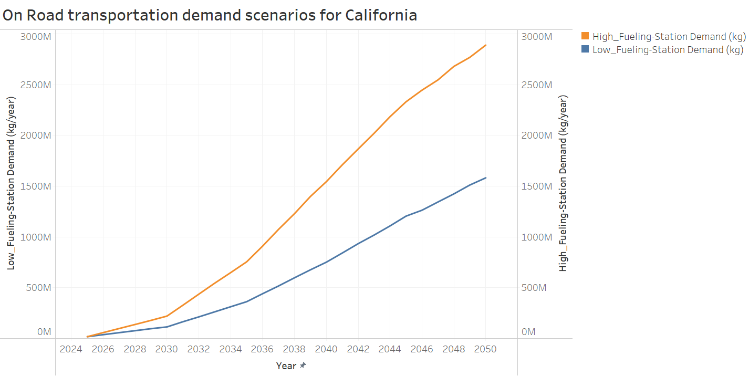
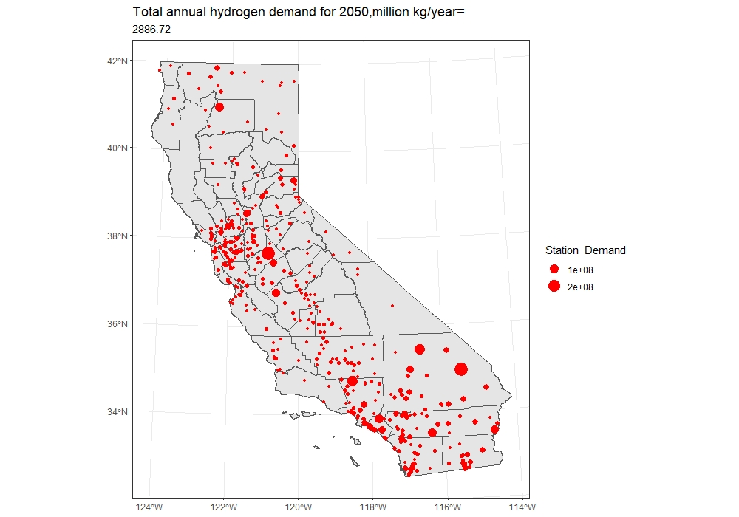

Hydrogen demand-STIEVE
450 demand nodes(TAZs)
405 demand nodes
https://engaging-data.com/pages/scripts/Davis/stationsmap4.html

Slide 10
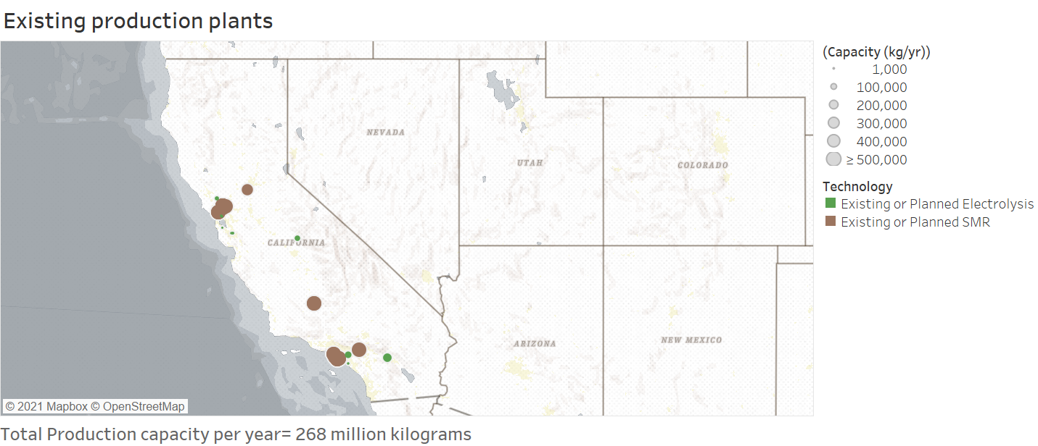
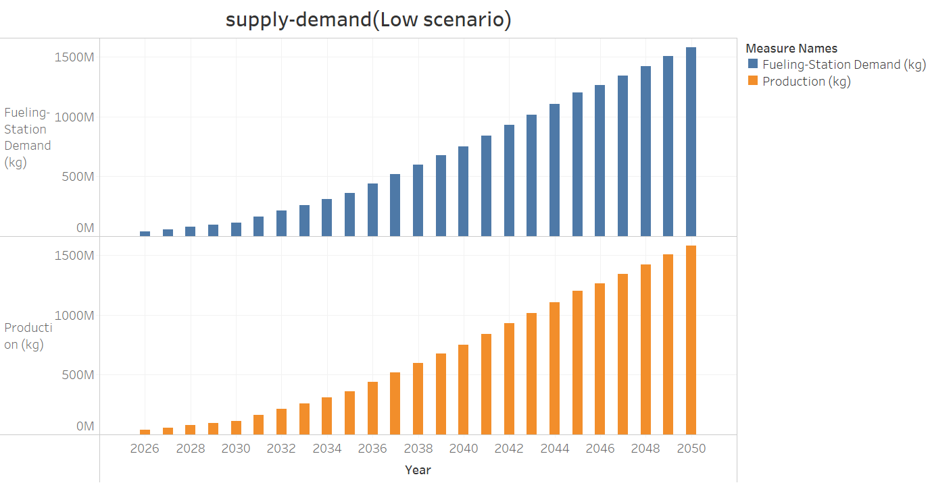
Most existing H₂ production is captive (IHS market database)
Electrolyzer installations are expected to be online towards 2022 ( DOE)
SERA follows a demand driven modelling approach
Builds infrastructure based on demand outlooks for 5 years ( typically).

Slide 11
RESULTS Scenario I – low and high transport demand, 5-year planning horizon

Slide 12
Hydrogen Production

Slide 13
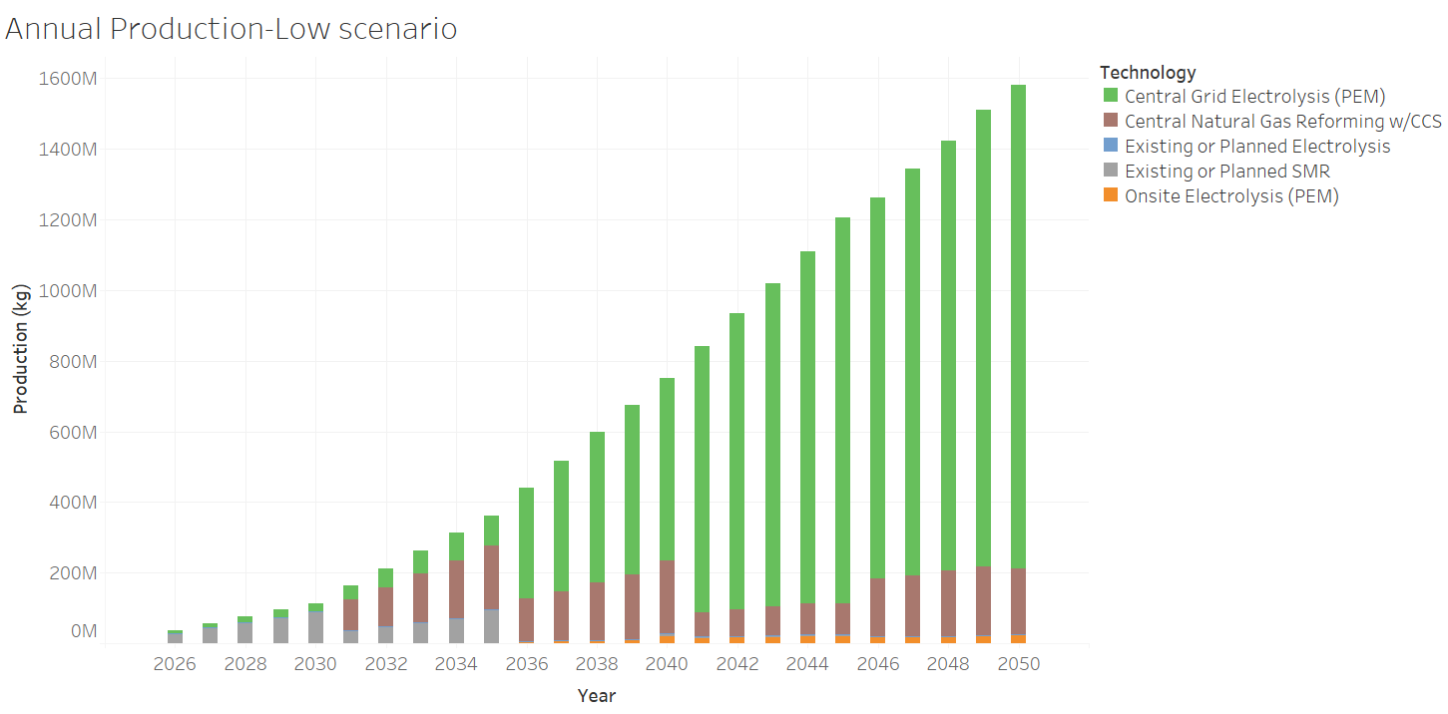
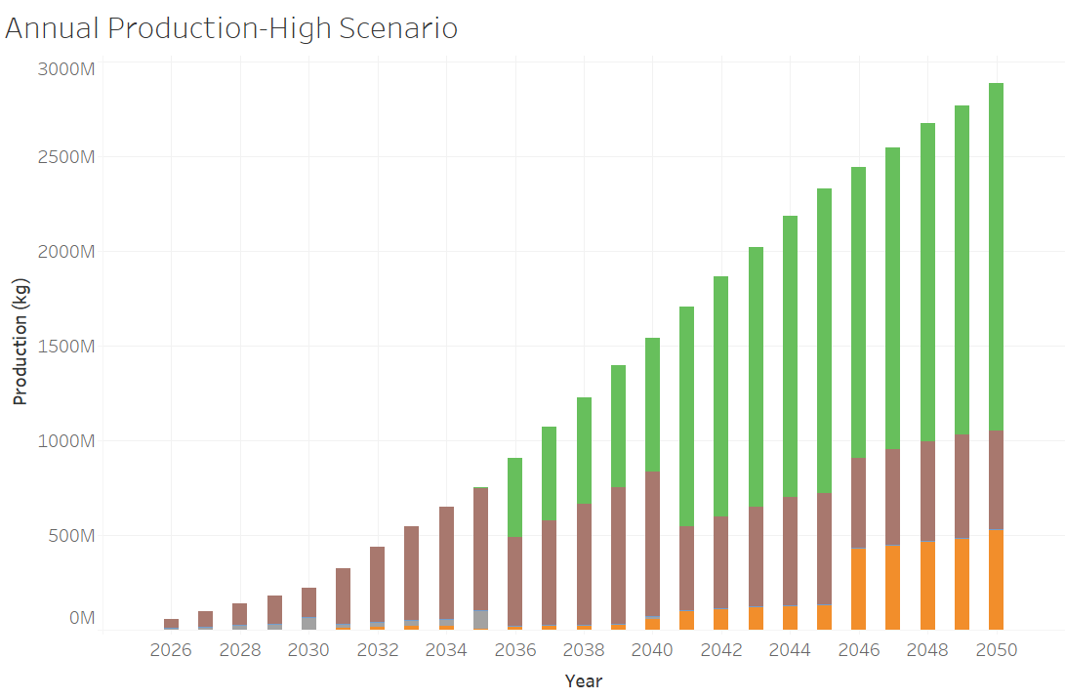
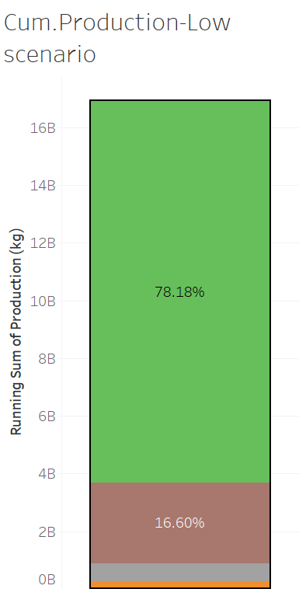
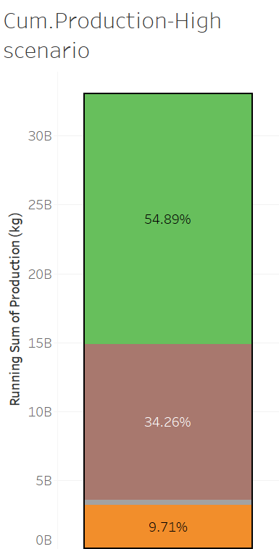
A high demand scenario builds more Central SMR with CCS initially, leveraging the economies of scale of these large plants.
Electrolysis dominates in both scenarios after 2035, larger share in low scenario.
Onsite hydrogen production more prevalent in high scenario after 2035, mostly to meet marginal demands

Slide 14
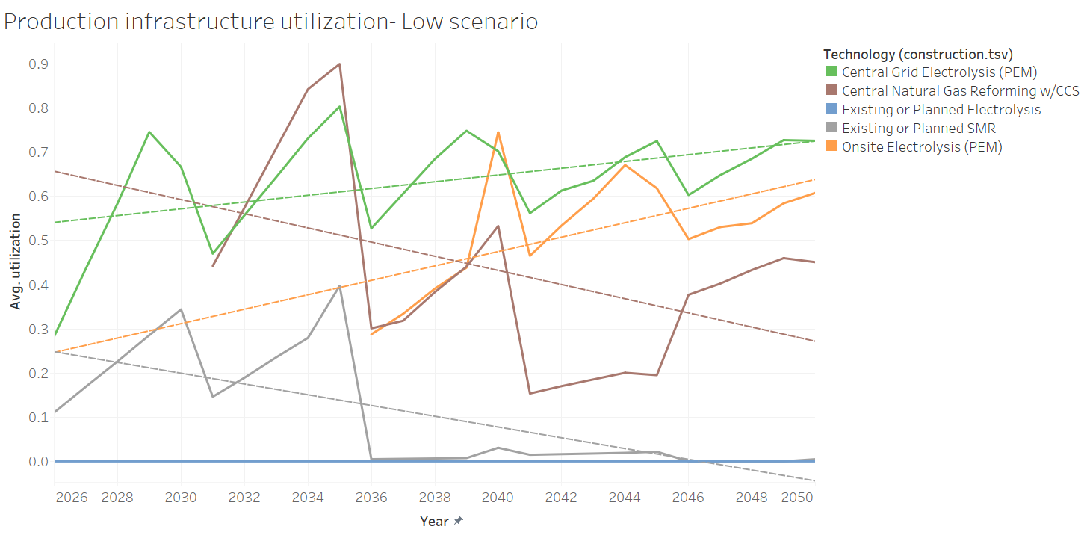
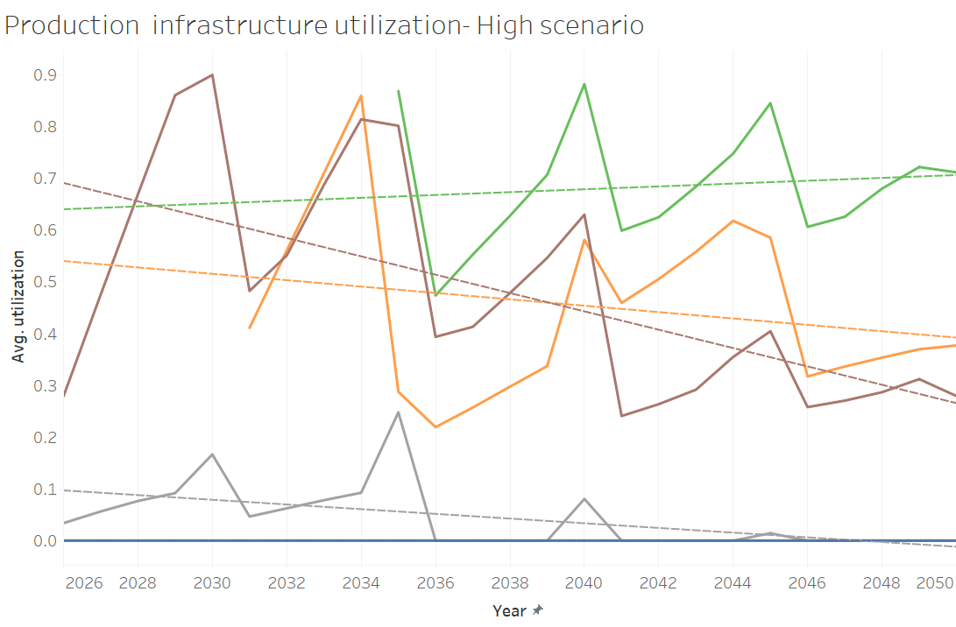
- - - -Trend lines
Very large SMR plants built during the earlier years have lower utilization in the future.
Electrolyzers see better utilization over the years.
Existing SMR plants( not built by SERA) have higher utilization as compared to existing electrolyzers, probably due to larger production capacities of SMRs

Slide 15
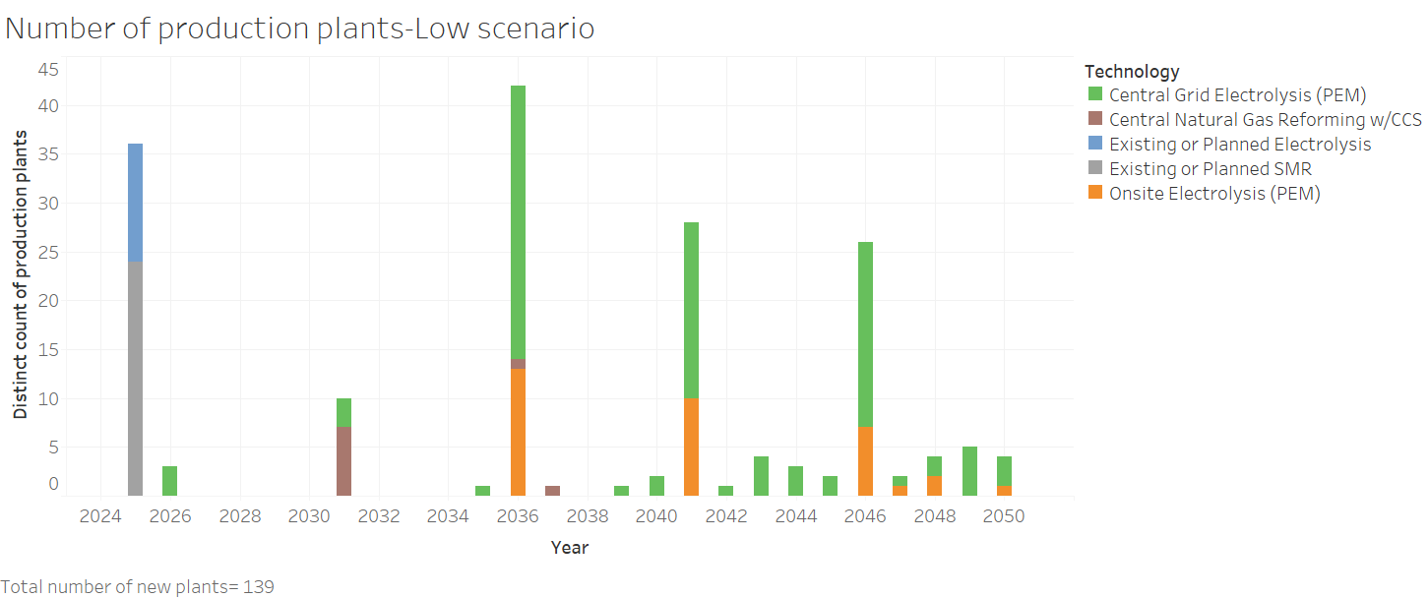
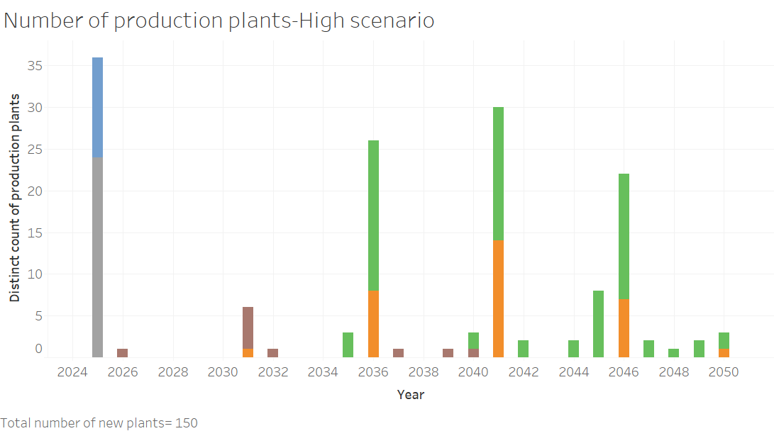
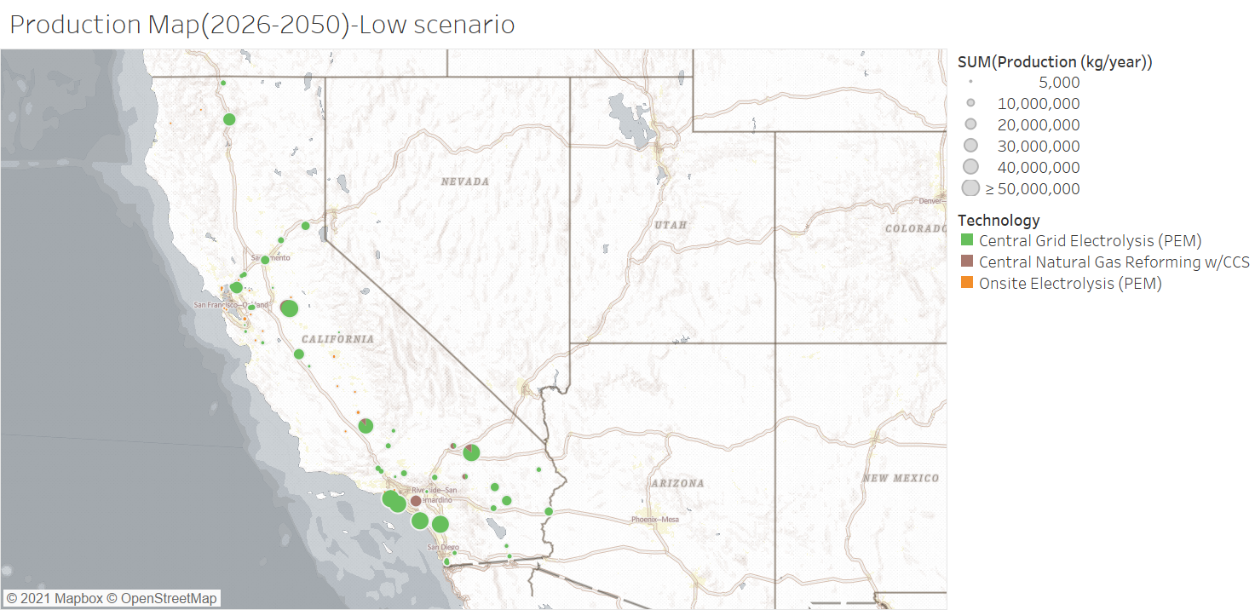
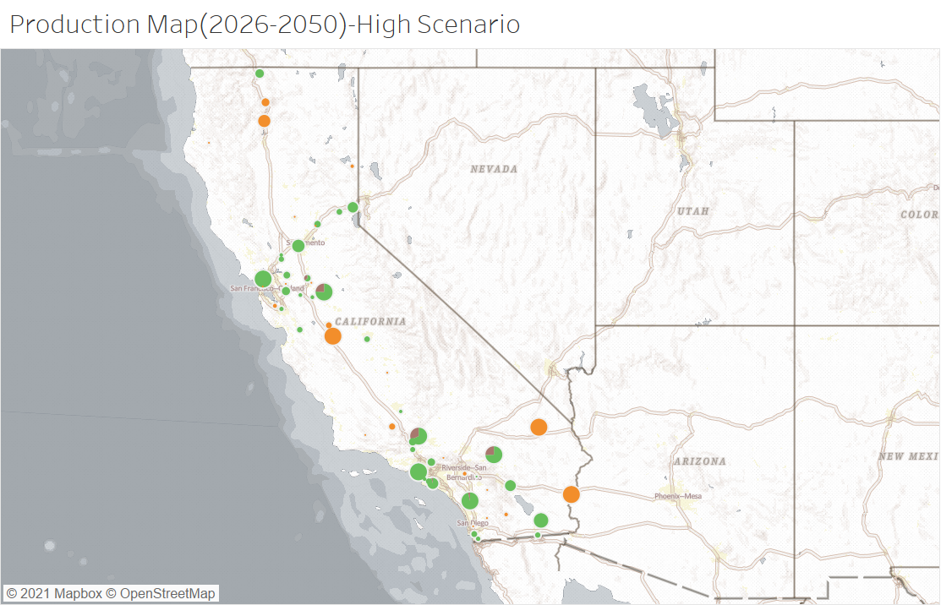
Most new constructions are electrolysis based, with a greater number of plants built for the high scenario
Onsite plants in high scenario are built away from urban areas

Slide 16
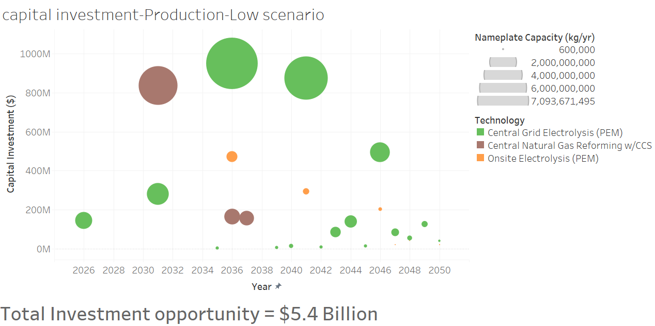
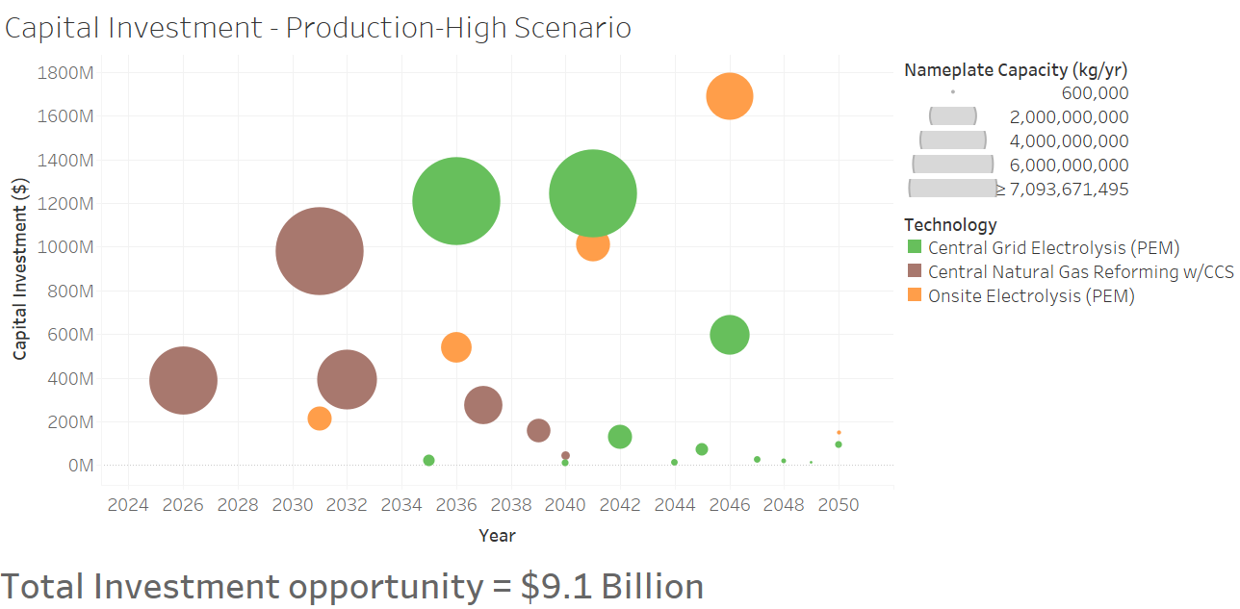
Investments in SMR extend into 2040 in the high scenario, unlike low scenario
All investments after 2040 are in electrolysis plants

Slide 17
Hydrogen distribution ( Gaseous tube trailers, Liquid tankers and Pipelines)
Scenario I – low and high transport demand, 5-year planning horizon

Slide 18
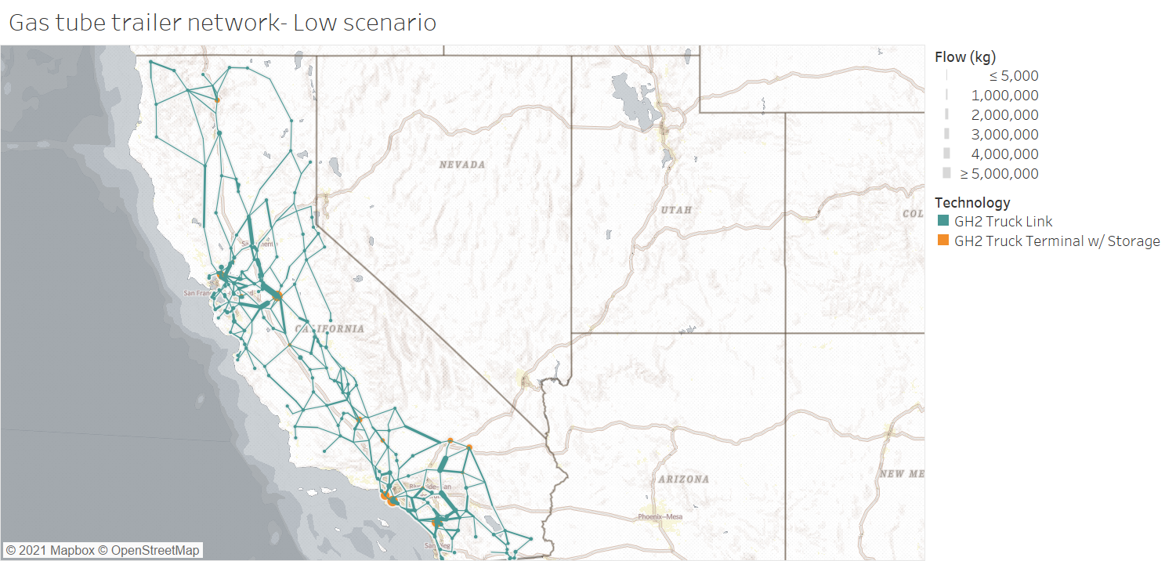
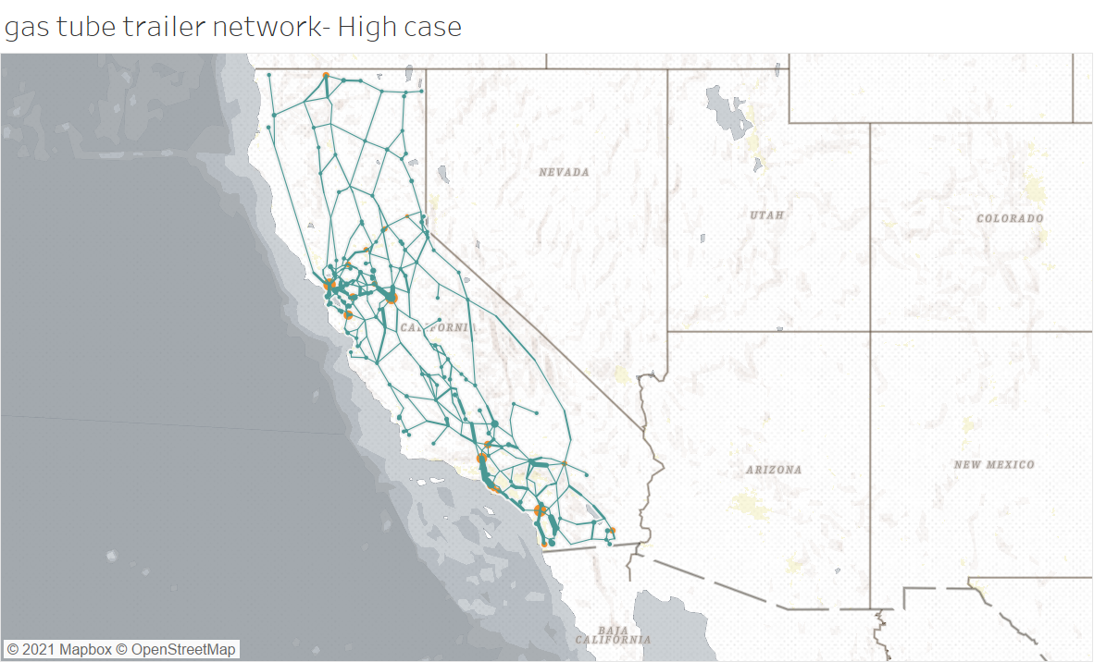
Most flow occurs in urban regions.
Max growth occurs between 2025-2035 in both scenarios.
In the low scenario, network growth is sizeable after 2035 as well.

Slide 19
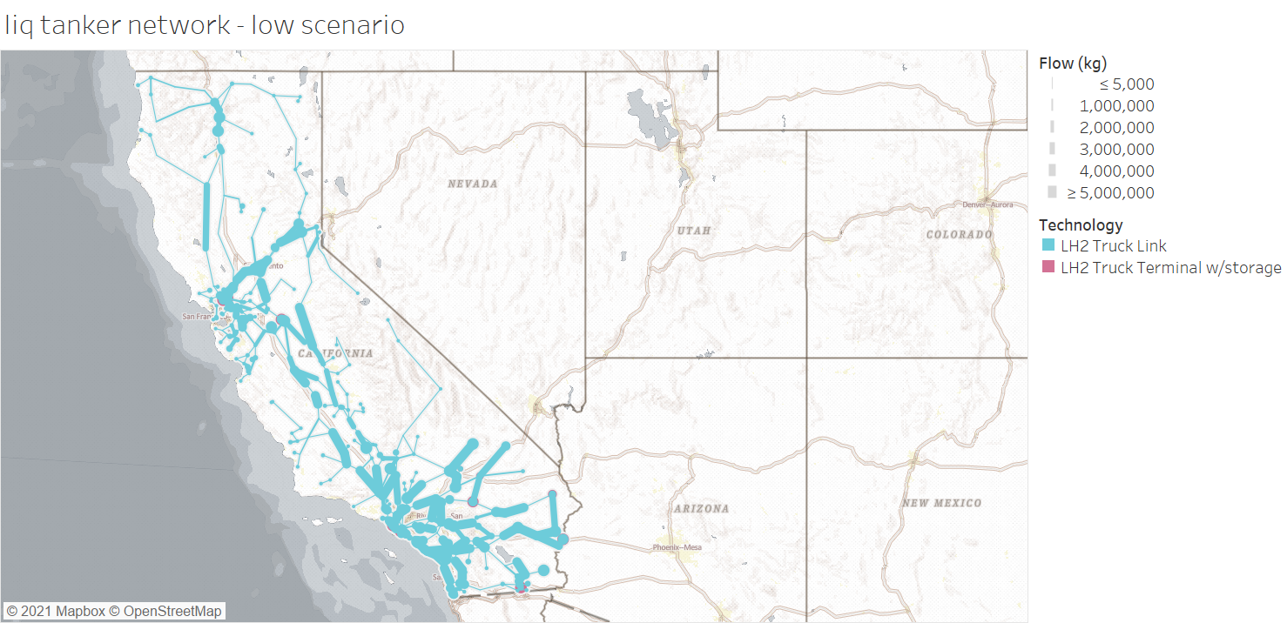
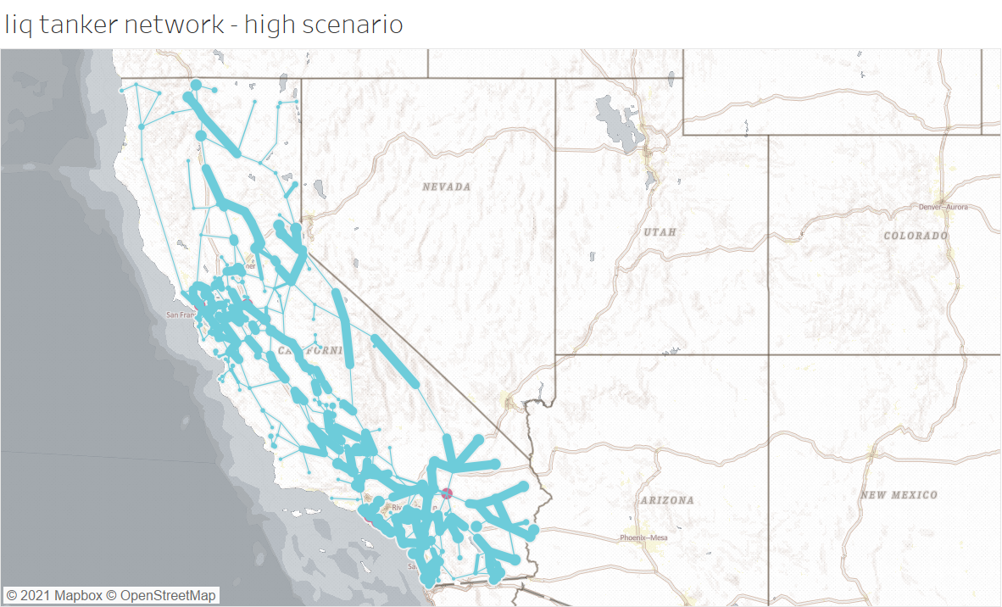
Sub-urban regions also have substantial flows, possibly truck stops.
Max growth occurs between 2025-2035 in both scenarios.
In the high scenario, sizeable network growth occurs after 2035 as well

Slide 20
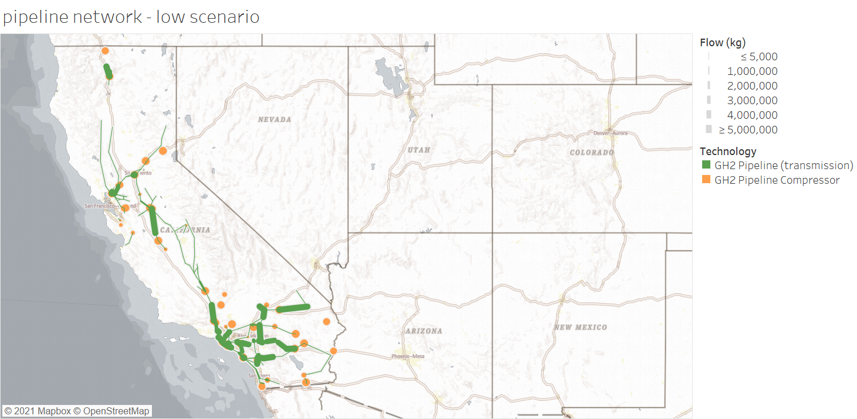
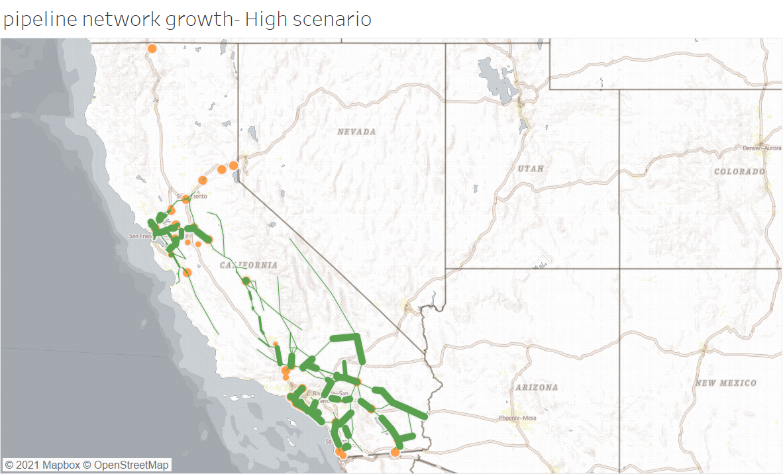
Length of pipelines= 7,008 km
Length of pipelines= 8,782 km
Southern California is a major hub for pipelines.
Pipeline growth occurs in discrete pieces, over the entire 25-year time period.

Slide 21
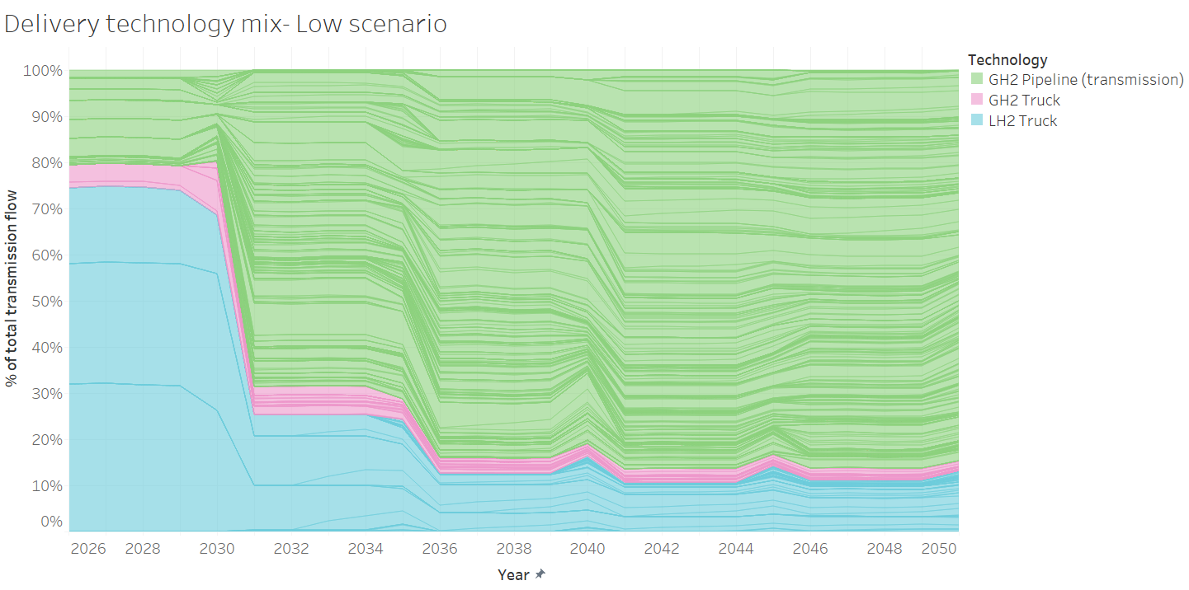
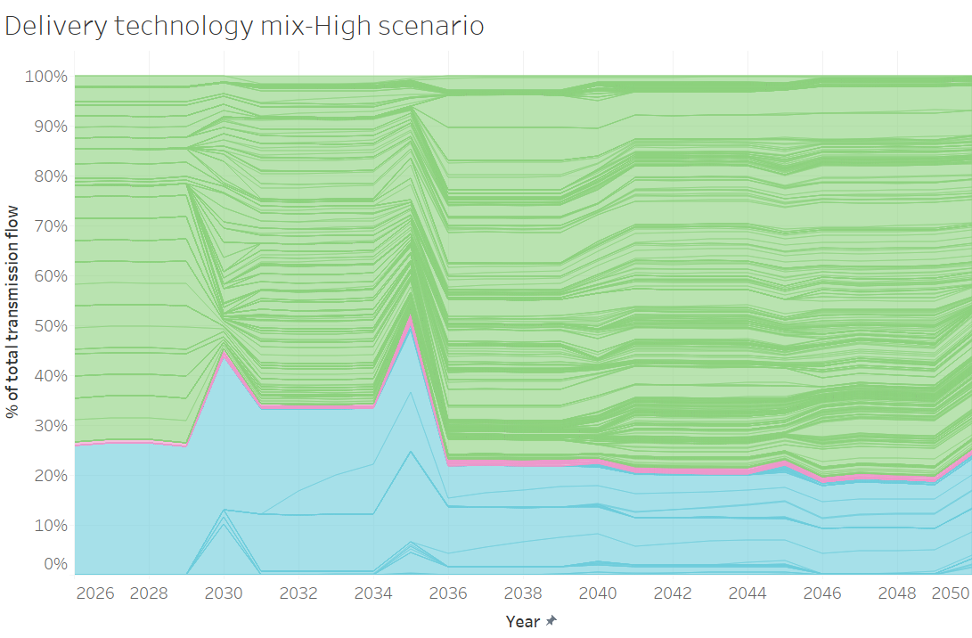
Pipelines reach about 80% share in both scenarios by 2036.
Gaseous tube trailers continue to play a role until 2050, though largely subdued in the high scenario
Liquid tankers play a larger role during the initial years in the low scenario, and hold a near constant role in the high scenario
Location of the demand point plays a very important role.

Slide 22
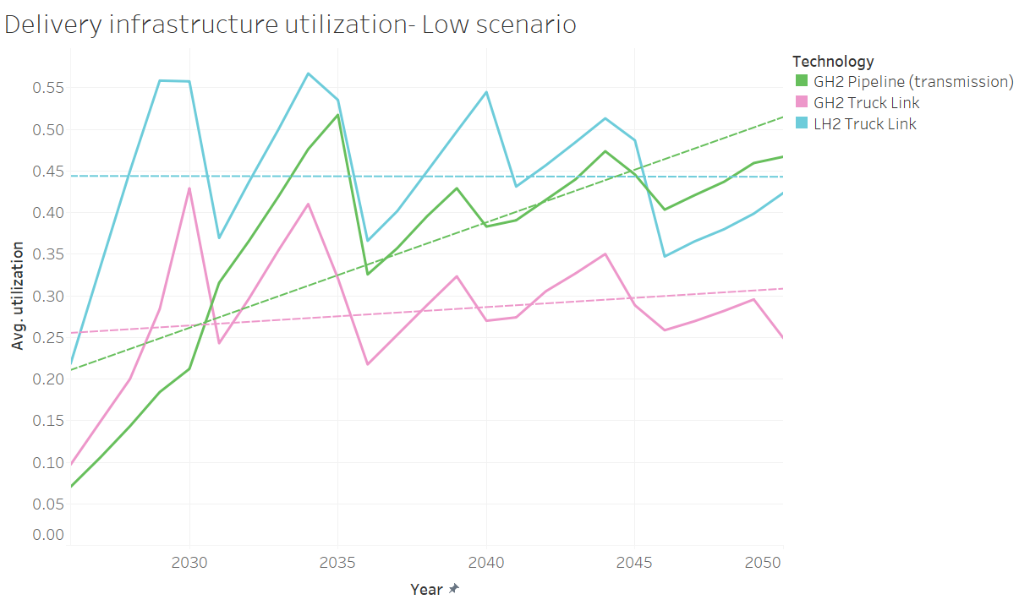
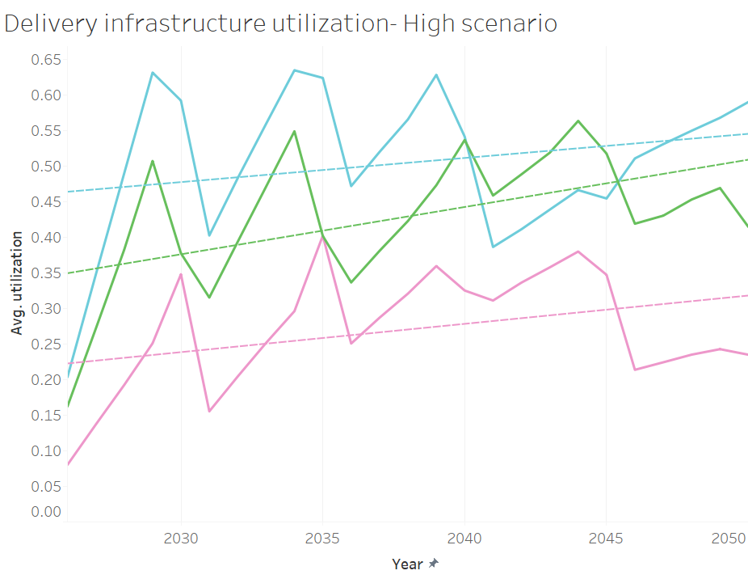
Average utilization increases for all three delivery modes in the high scenario
Tube trailers have higher utilization than pipelines in the low scenario, until 2030

Slide 23
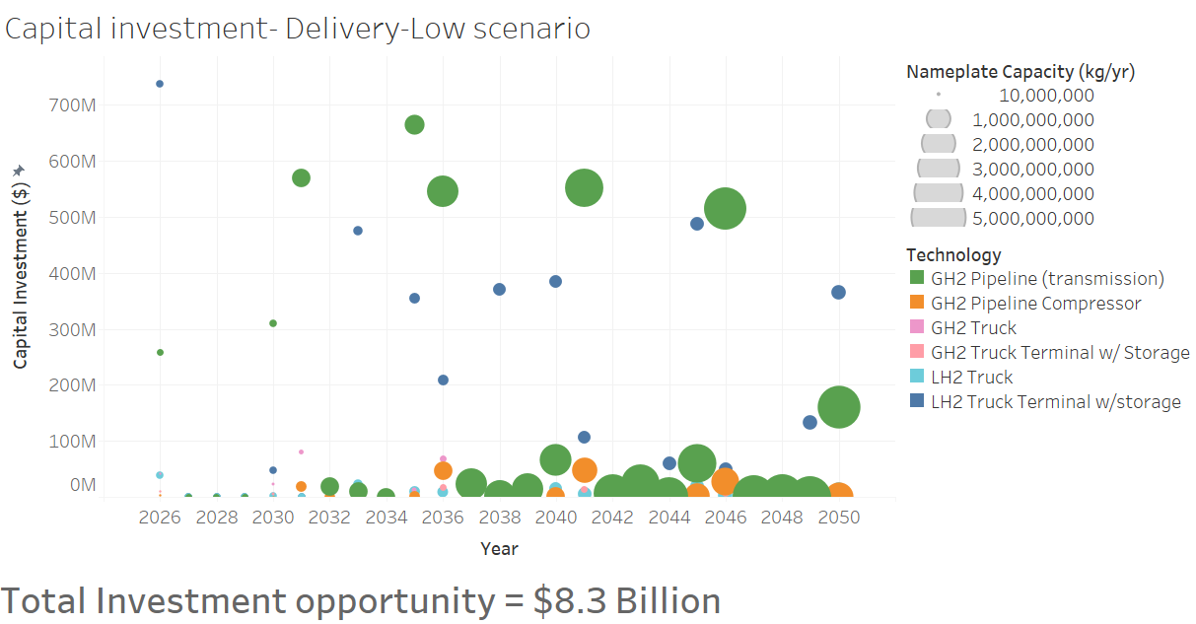
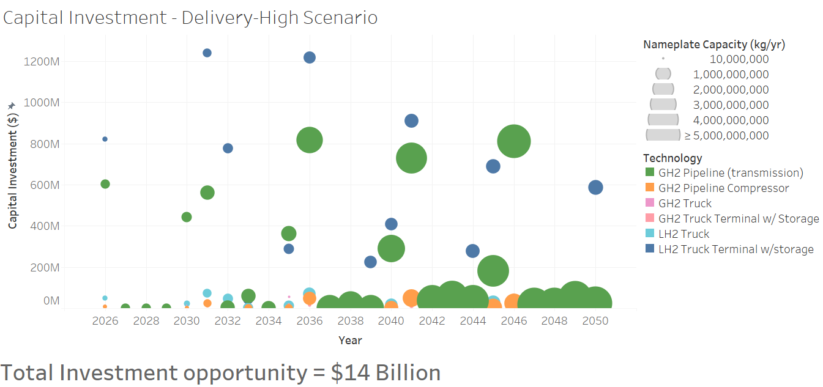
In both scenarios, pipelines(transmission) and liquid terminals have a substantial share of investment, and this start as early as 2026.

Slide 24
Refueling stations
Scenario I – low and high transport demand, 5-year planning horizon

Slide 25
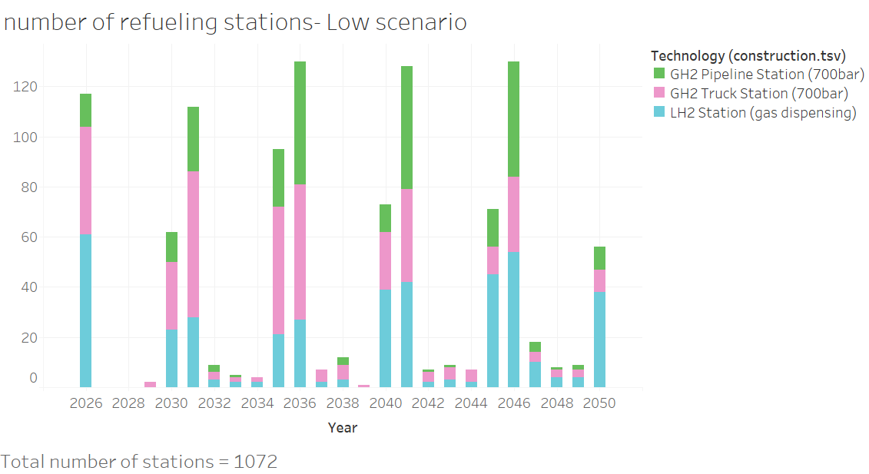
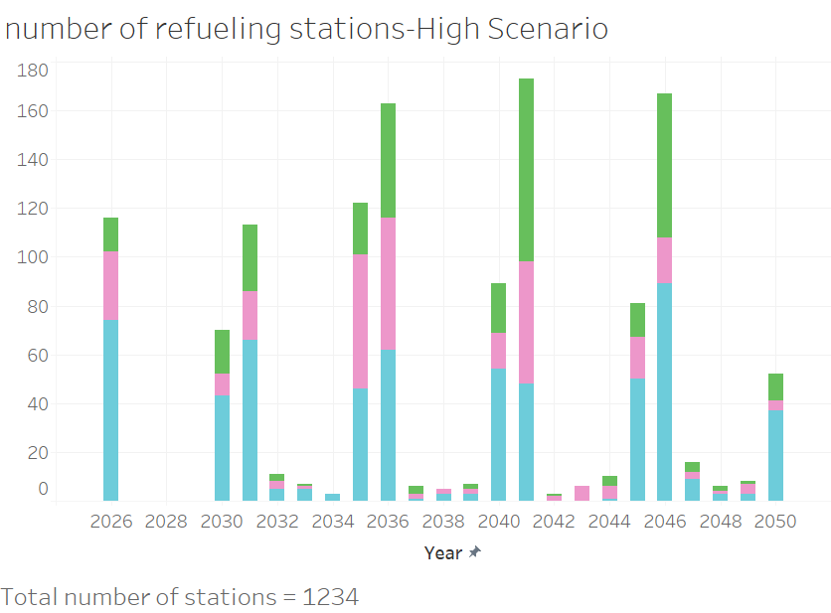
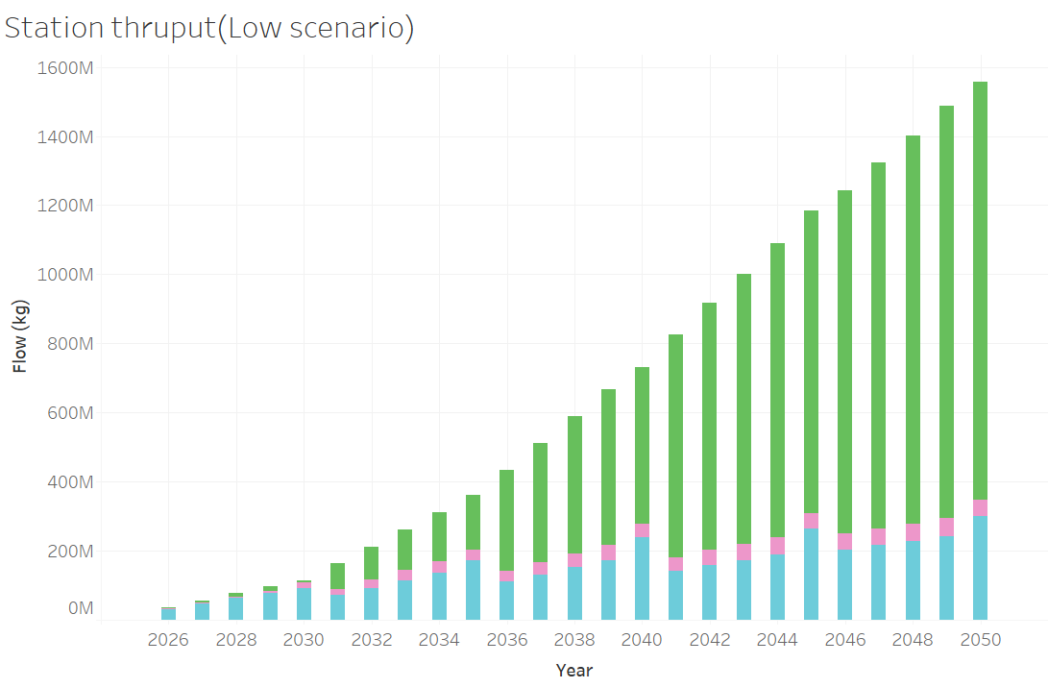
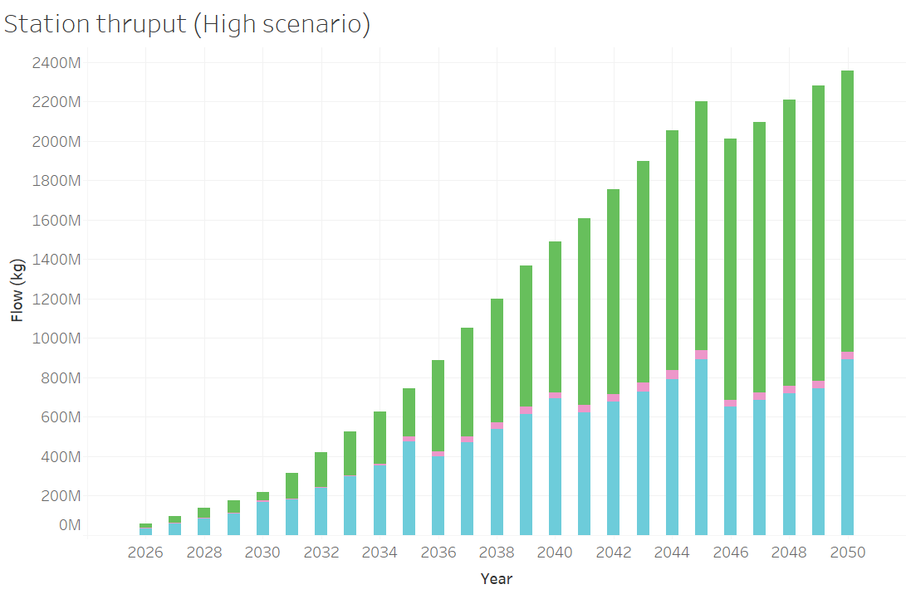
Refueling stations with a pipeline for hydrogen delivery have larger thruput

Slide 26
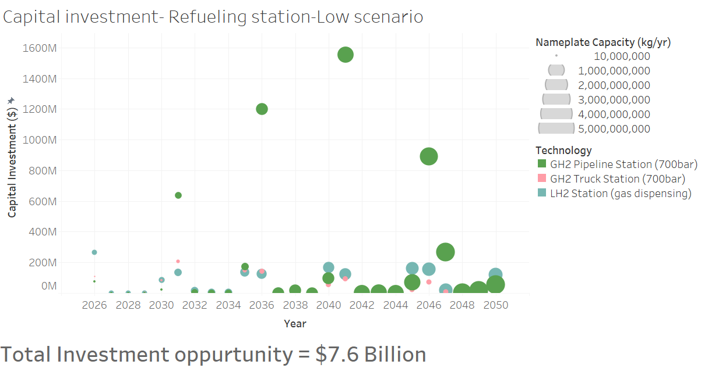
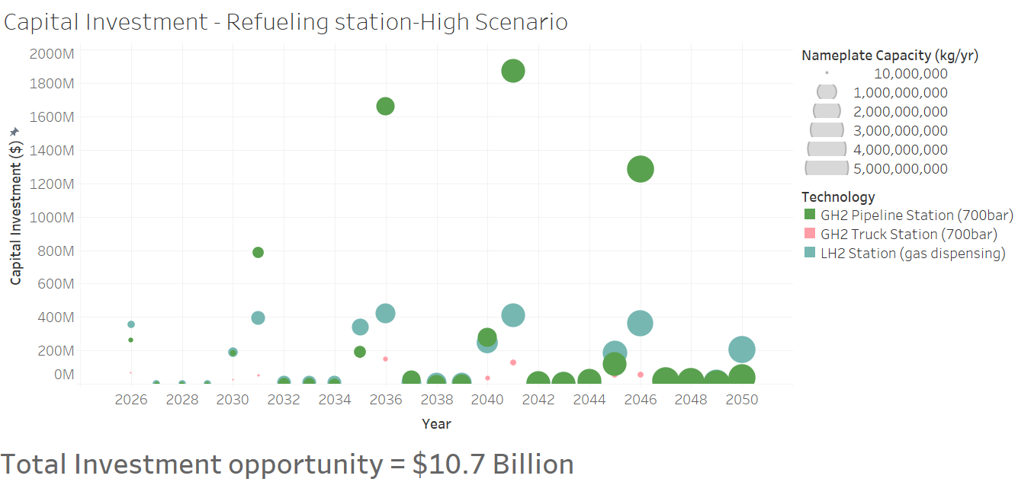
Refueling stations with pipeline delivery have high capital investments. Major capex of these stations are driven by costs of compression at the station.

Slide 27
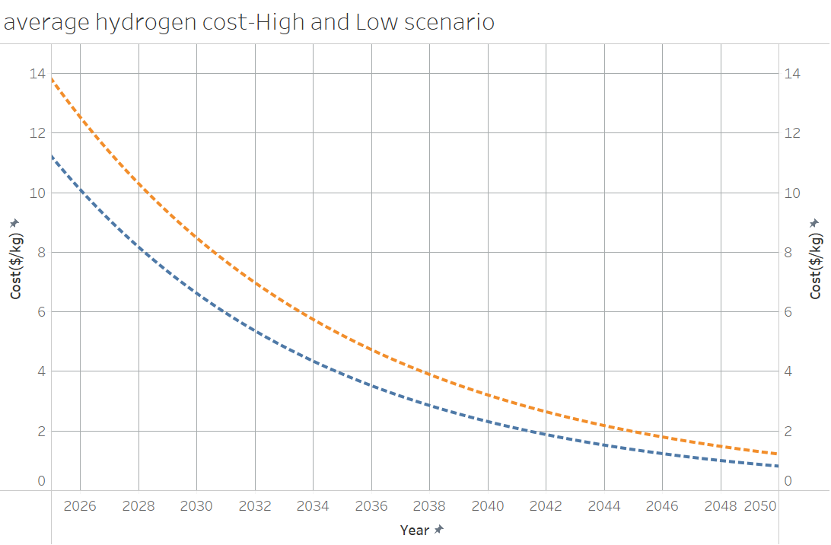
Cost of hydrogen at the dispenser($/kg)
Not the price consumer sees!!!
Low demand
High demand
Demand drives down the costs of hydrogen, more evident in early years
$5/kg mark achieved by 2035 in both scenarios

Slide 28
Scenario-II -Planning horizon 5-year, 12-year, 25-year -High demand

Slide 29
Hydrogen production

Slide 30
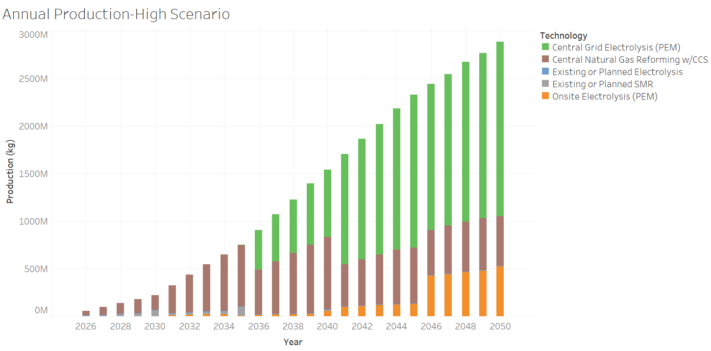
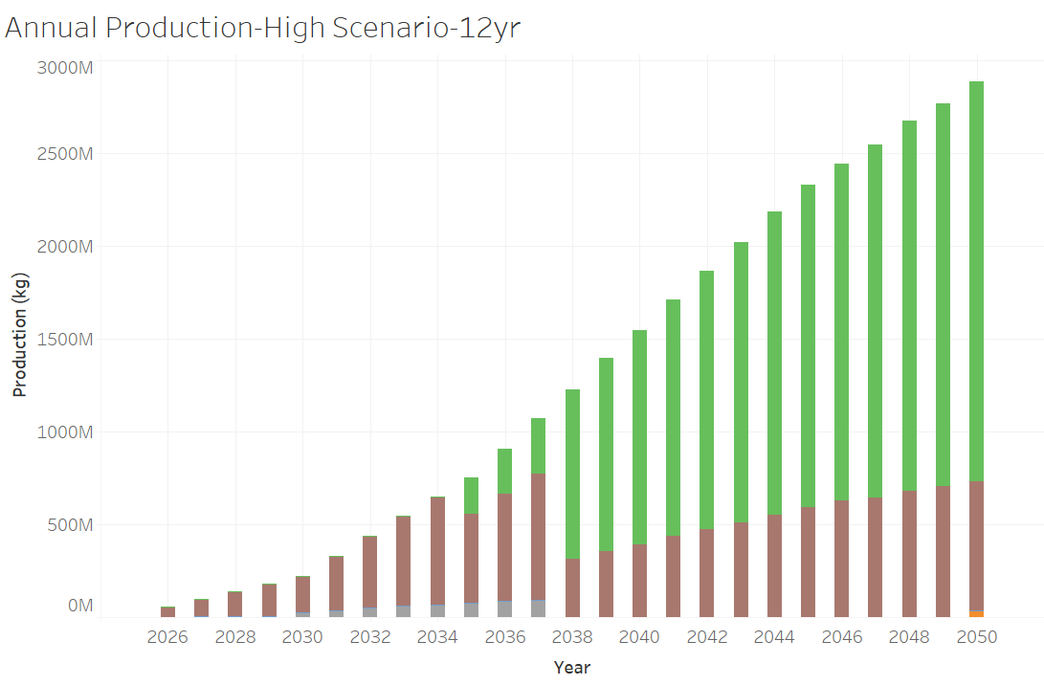
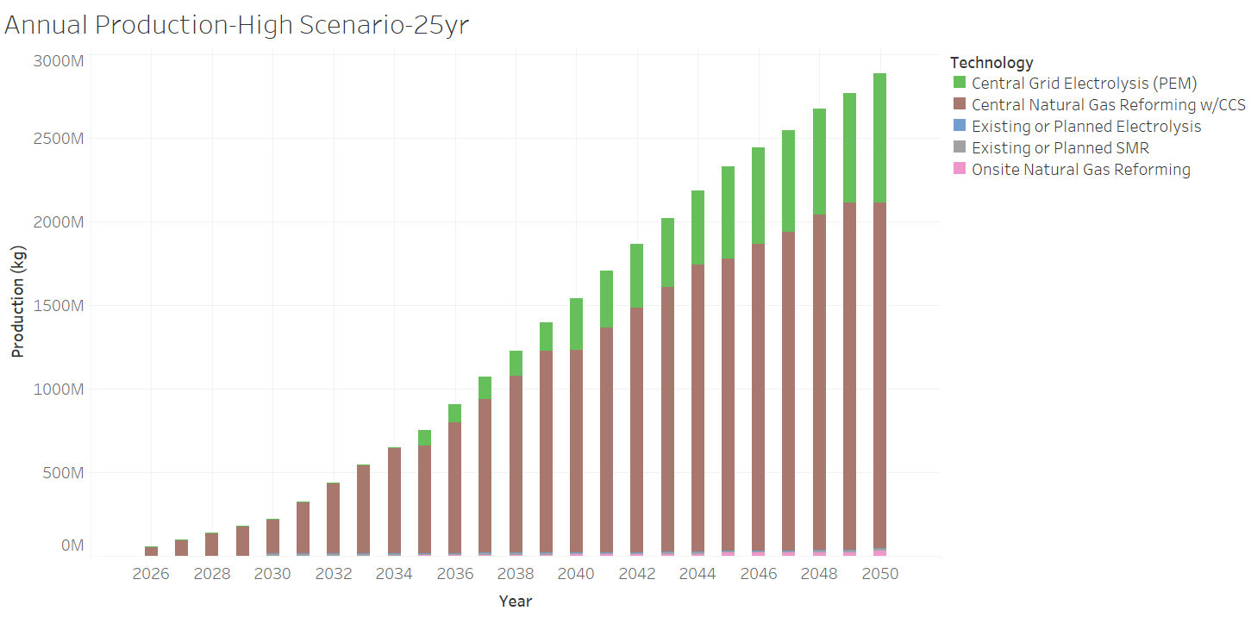
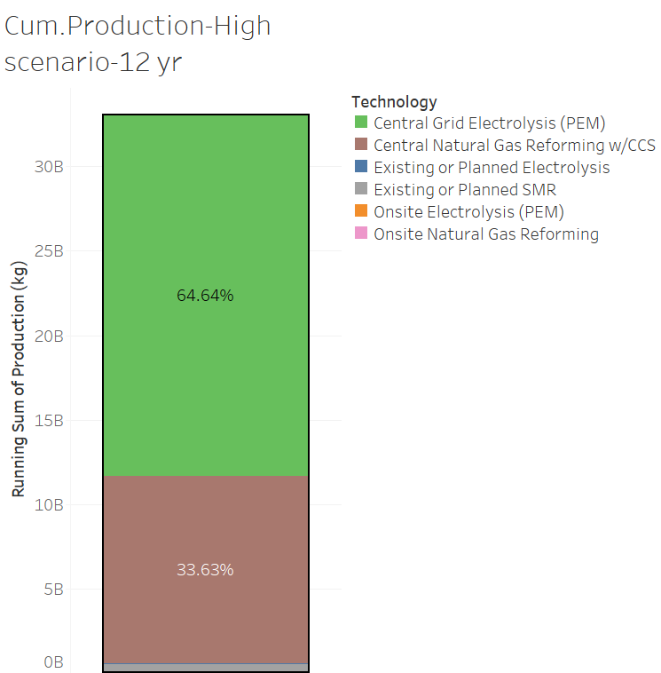
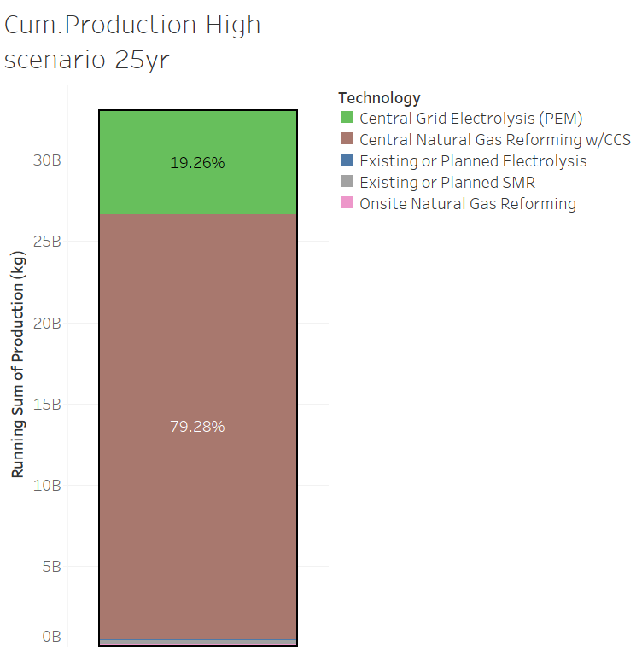
A very long and perfect foresight enables building of large SMR plants with CCS, leveraging economies of scale
Onsite production is minimized in perfect foresight scenarios

Slide 31
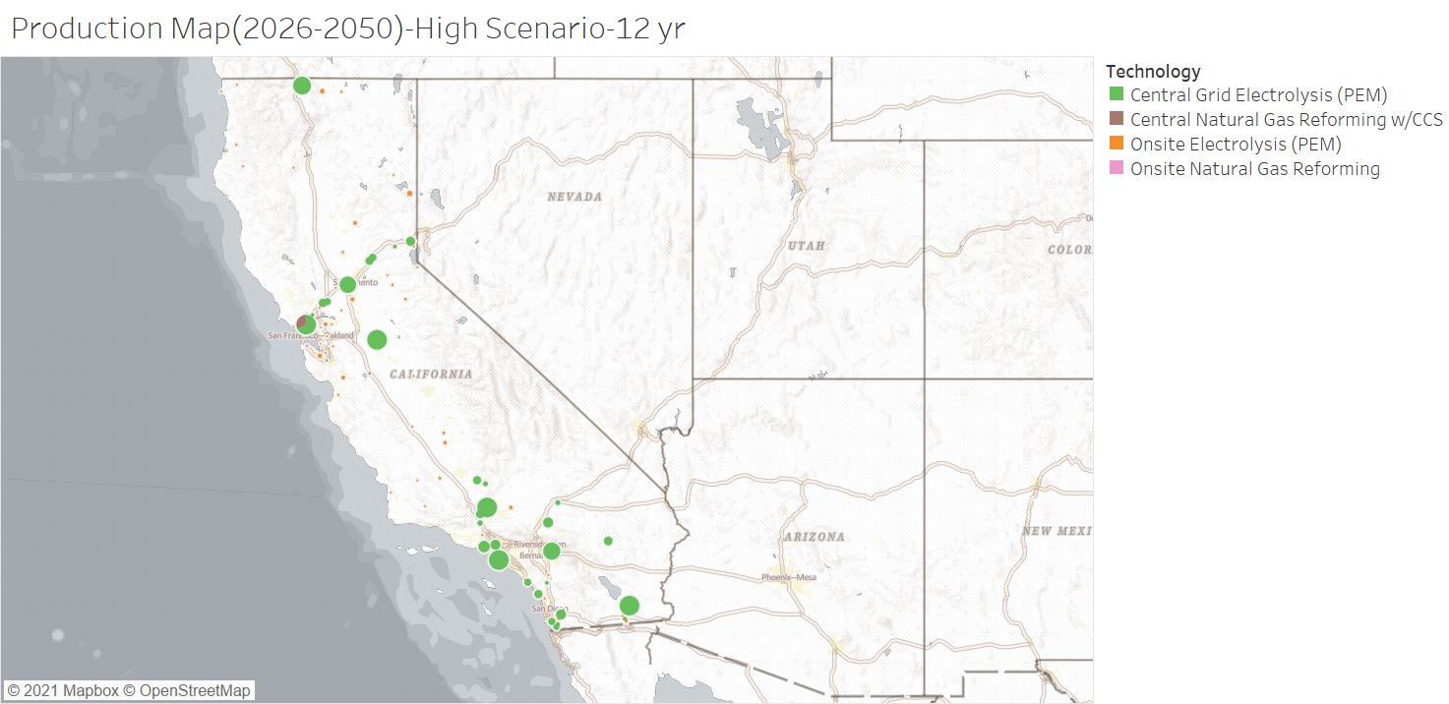
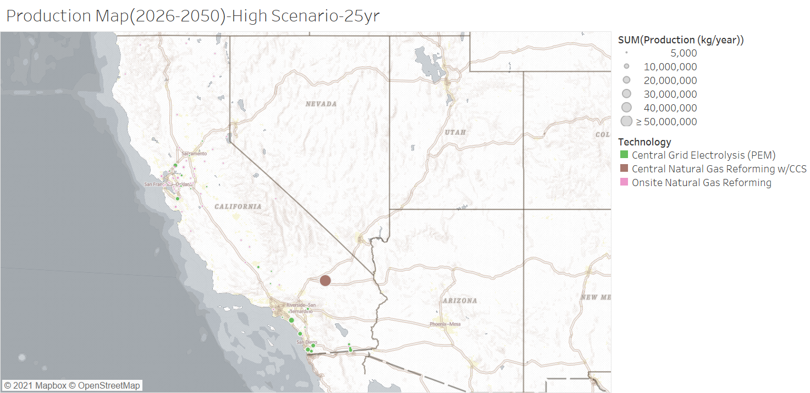

Slide 32
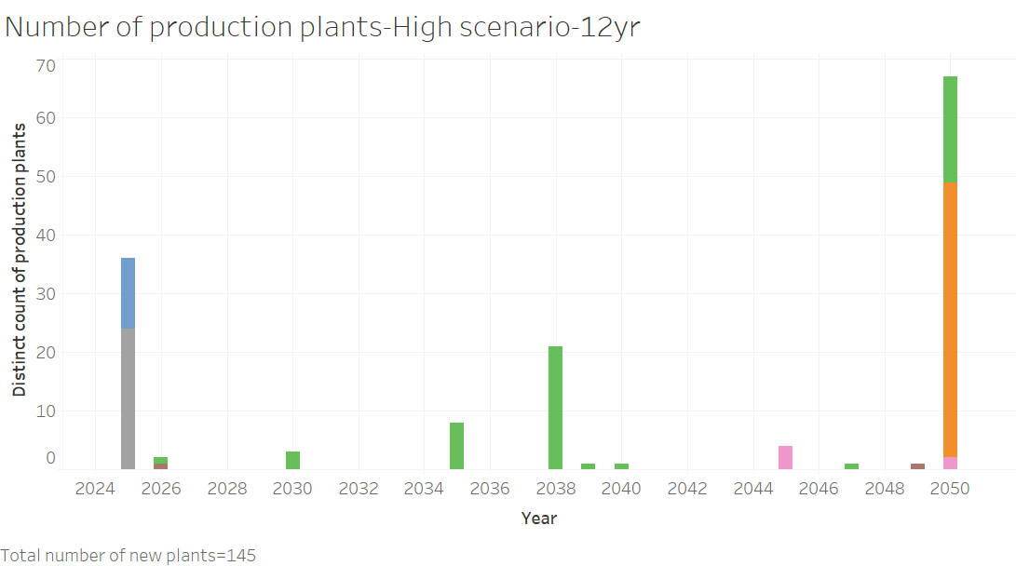
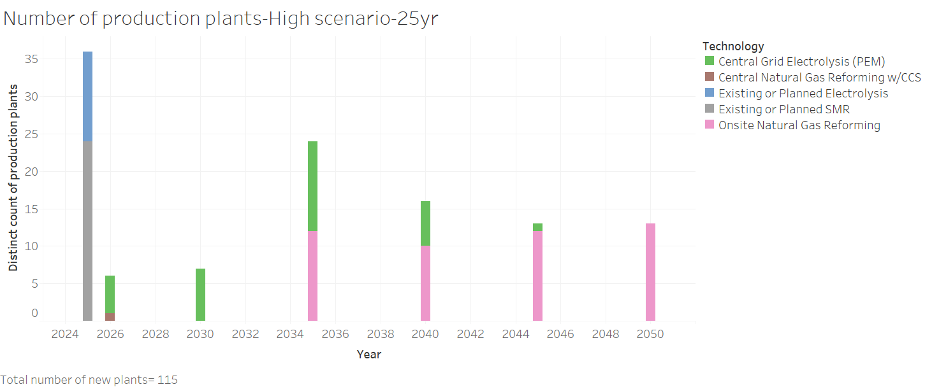

Slide 33



Slide 34
Hydrogen distribution
Scenario-II -Planning horizon 5-year, 12-year, 25-year -High demand

Slide 35


Average utilization increases across all modes of distribution with better foresight

Slide 36
Refueling stations
Scenario-II -Planning horizon 5-year, 12-year, 25-year -High demand

Slide 37


Lesser number of stations built with longer planning horizons

Slide 38

Low
High
12 year
25 year
A perfect foresight results in higher costs during the initial years but then, the costs rapidly falls

Slide 39
Conclusions
Demand (both in terms of volume and time) can have substantial impacts on the hydrogen supply chain.
Higher demand drives down the cost of hydrogen, especially during the early years.
Certainty in demand(perfect foresight) enables improved utilization of hydrogen infrastructure.
Production:
With limited demand foresight(5-year planning horizon),
Building large centralized electrolysis plants that have cheap access to renewable electricity is most cost effective
Onsite hydrogen production caters to satisfying marginal demands in sub urban areas.
With perfect foresight, there are fewer and larger centralized production(SMR and Electrolysis).
Distribution:
Gaseous tube trailer delivery mode is dominant in the high demand clusters that are at short distance from the production plants
Pipelines(dedicated h2) are the preferred mode of distribution for the future(in all scenarios).
Liquid tanker's role is more evident in the initial years in a low hydrogen demand scenario
Refueling:
Stations with liquid and pipeline delivery have greater scope for scaleup, but is very capital intensive

Slide 40
Future work
Extend geography beyond California, to cover the WECC region.
Include hydrogen storage(geological and line pack)
Include non transport demand

Slide 41
Thank You !
vvijayakumar@ucdavis.edu /
Vishnu.Vijayakumar@nrel.gov

Slide 42
BACKUP

Slide 43



Slide 44




Slide 45


Refueling station capital costs

Slide 46


Utilization decreases over time for all except those which gets hydrogen supply from pipelines

Slide 47



Slide 48



Slide 49



Slide 50
Comparison of distribution network growth(2026-2050)
Gas.tube trailer
Optimization time period | Length(km)
5 year | 20,010
12 year | 13,230
25 year | 8,331
Liq.Tanker
Optimization time period | Length(km)
5 year | 42,850
12 year | 26,290
25 year | 14,996
Pipelines
Optimization time period | Length(km)
5 year | 8782
12 year | 8216
25 year | 3636

Slide 51


Slide 52
Scaling of delivery technologies

